Slide 1
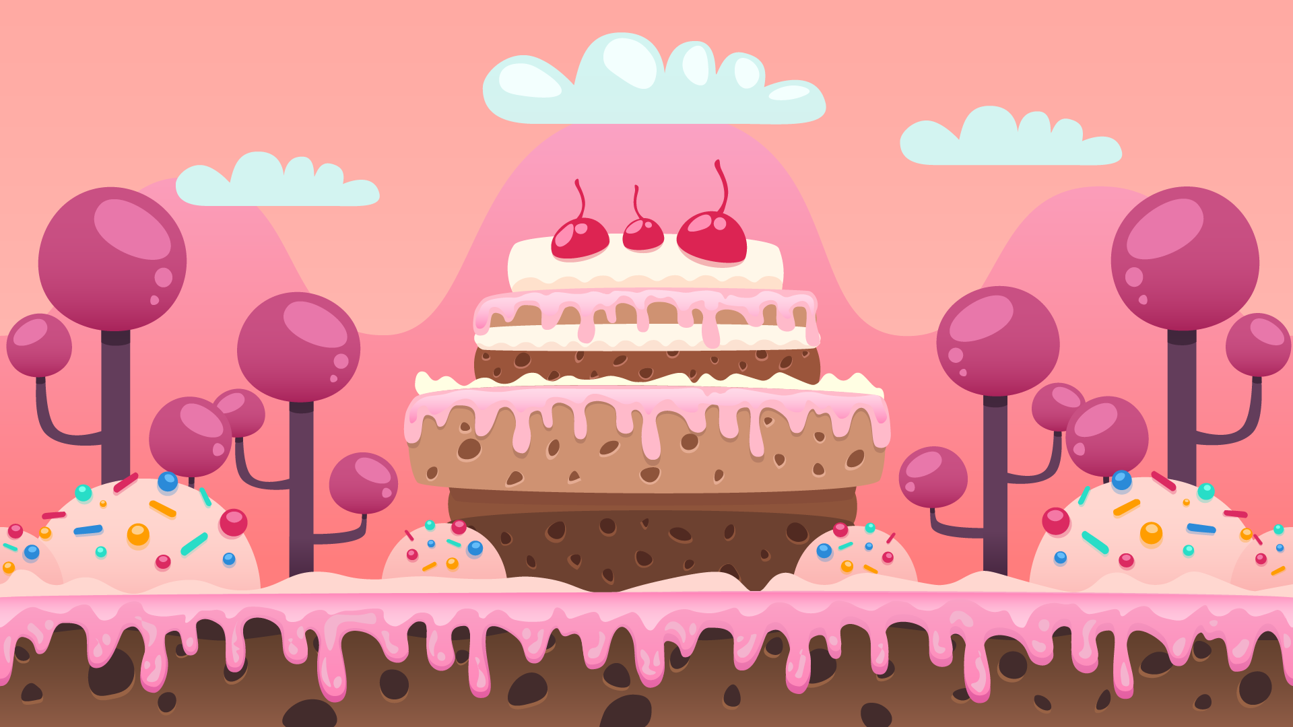
Dino run
By: Courtney Wiest

Slide 2
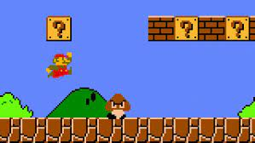
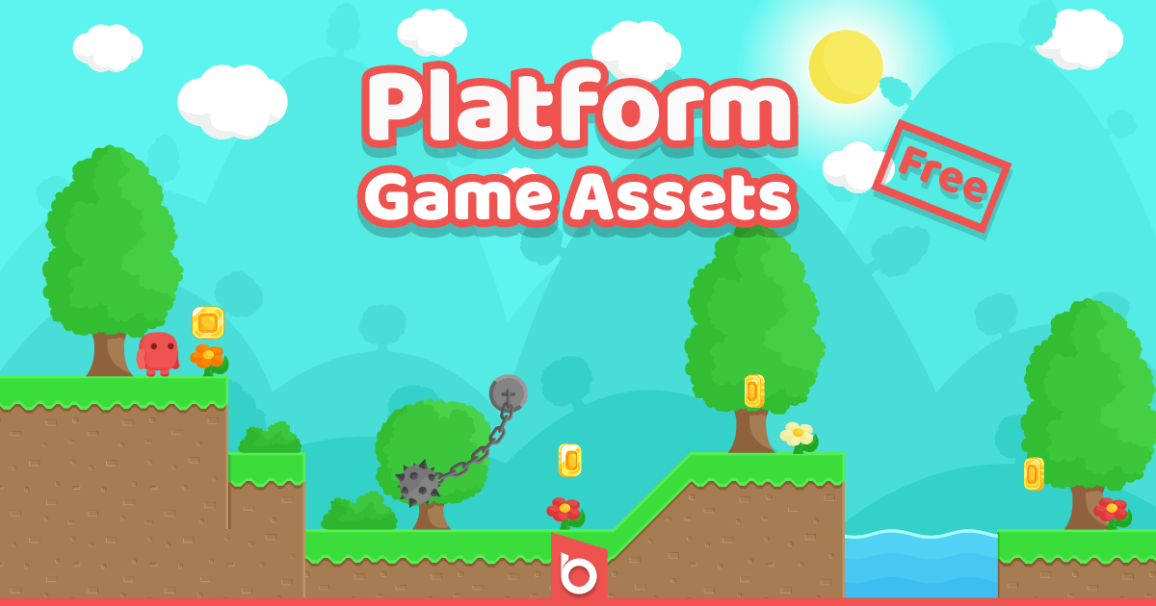
Influences/Inspirations
Super Mario Bros.
Platform Asset from Unity

Slide 3
Storyboard
The backstory for the game is that you are the character and have been transported to the cartooned themed world(s) in the past. You must go through each level, collecting meteors and coins, and defeating enemy purple dinosaurs. Players will use the meteors to throw at the dinosaurs along their path defeating/killing them, and the coins that players collect will eventually add to their health when reaching a certain amount. In theory, the coins would also be able to be used to purchase different things like characters, outfits, etc., but I don’t think my game will become quite that advanced. Players must complete each level and defeat all the dinosaurs in order to kick off the “big bang” and evolution, inevitably saving mankind.
I think that I am funny and so I chose meteors to once again defeat/cause the dinosaurs to go extinct.

Slide 4

Character(s)
You have been transported to different cartoon worlds of the past.
Your goal is to make it through each level/world, collect meteors, and use them to defeat/kill the dangerous dinosaurs along the way.
By doing so, you’ll once again, defeat the dinosaur race with meteors, and will have therefore started the chain reaction of the ”big bang” and evolution in order to save humanity.
(Ideally, you will get to choose from a few different options of characters to play as)

Slide 5
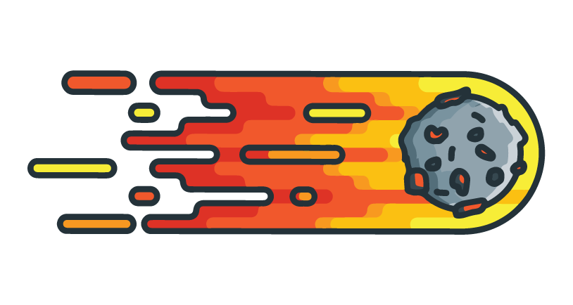
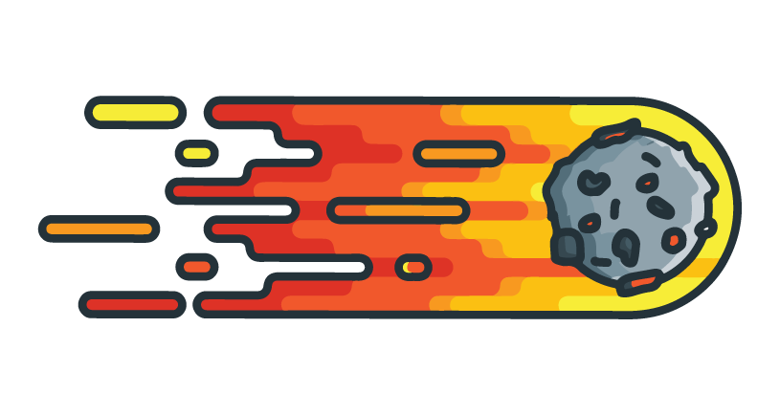
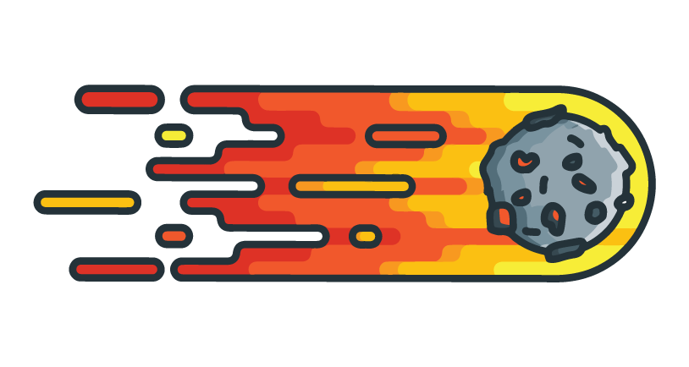
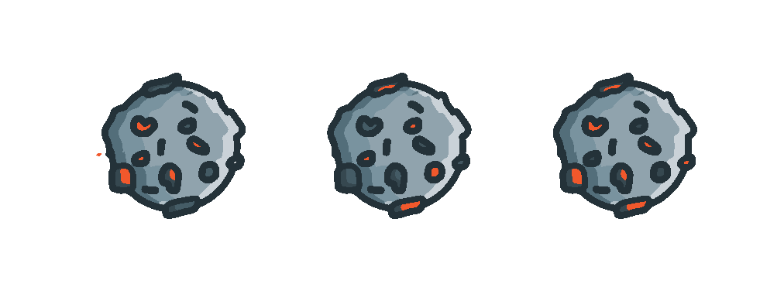


Enemies & Collectibles
Purple Dinosaurs will be the player’s enemies, and they will be randomly placed along the player’s path.
Coins will be placed along the players path for them to collect. A certain number of coins will increase the player’s health.
Meteors will be placed along the players path for them to collect. The players will throw these at the dinosaurs that are also along the path in order to defeat/kill them.

Slide 6
Timeline
Have all my assets placed within the game and animated. (player, meteors, coins, dinosaurs, etc.) -- by the end of October
Have all my game mechanics work. (things can be collected, meteors can be thrown at dinosaurs, dinosaurs cause damage to players, etc.) – by mid-November
Have all my music and sound effects added and have a certain amount of coins collected increase the player’s health-- by the Final due date: mid-December
Add different levels to load after players have completed the first, main level – time permitted – by the Final due date: mid-December

Slide 7
Estimate of completion
By the end of the semester, and the due date of the Final for this class, I would like to have at the very least one full function level completed. This includes coins and meteors being collectable, a certain number of coins increasing the player’s health, dinosaurs damaging/decreasing the player’s health, meteors can be thrown at dinosaurs, and a certain number of those will kill/defeat the dinosaur.
I would love to add a few extra things like different character choices, additional levels, start screens, etc., but I’m not sure I’m going to get to those before this project is due. I’ll add these extra things with time permitting.

Slide 8
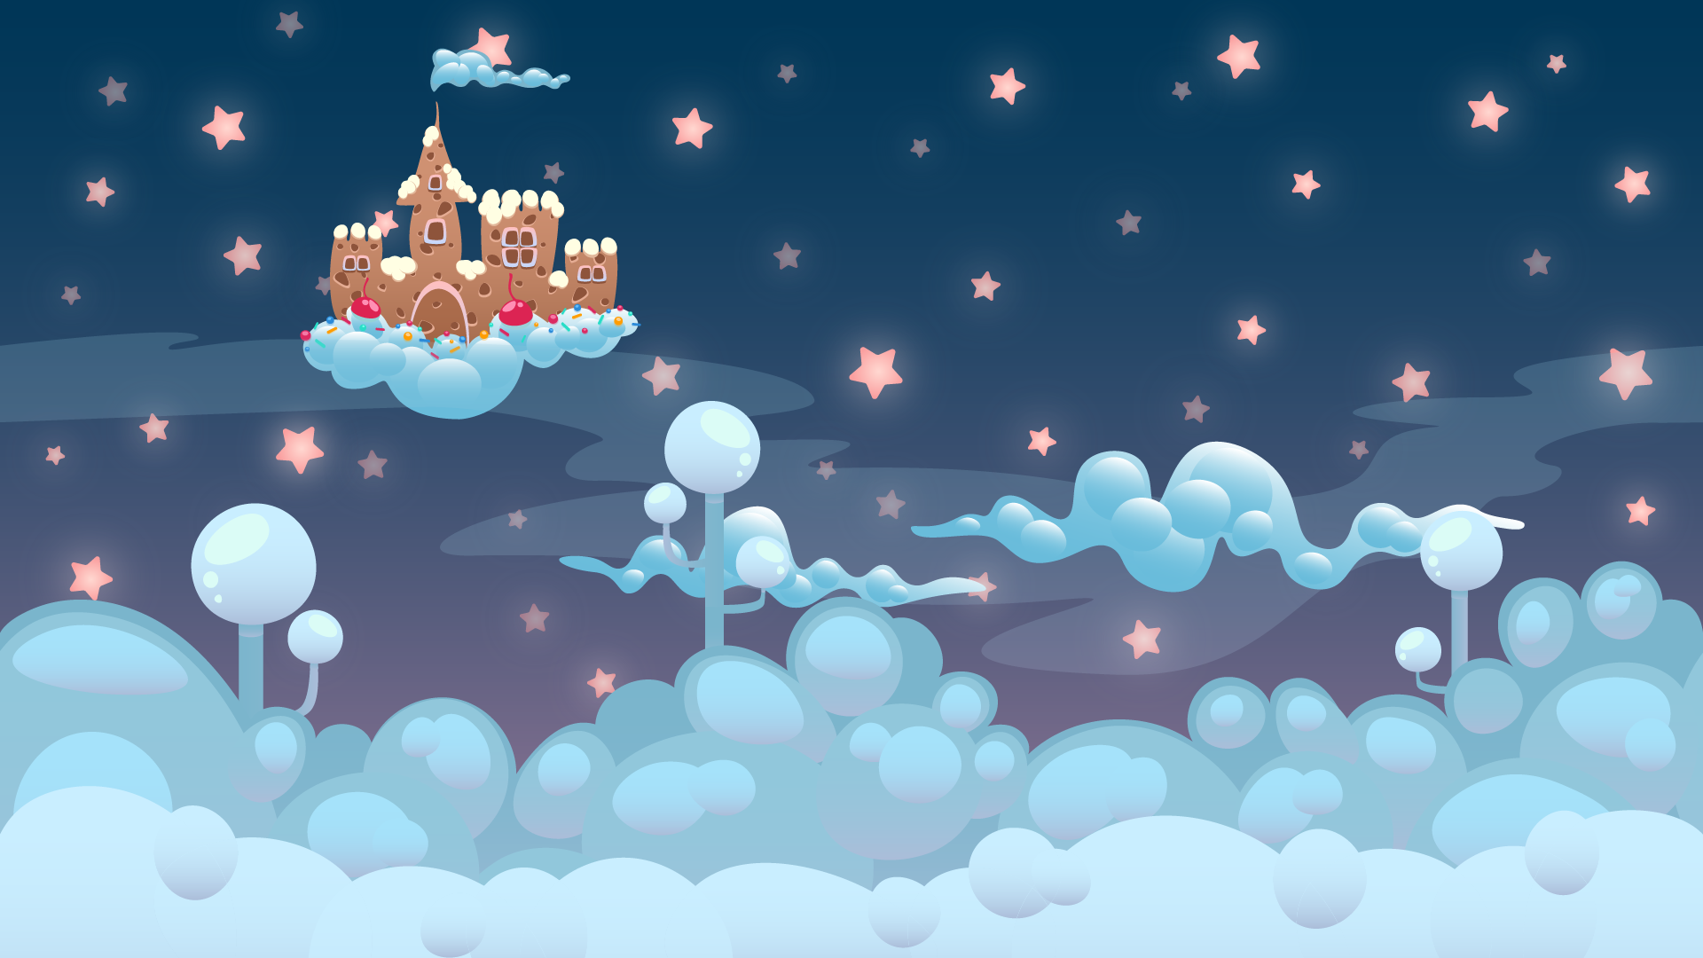



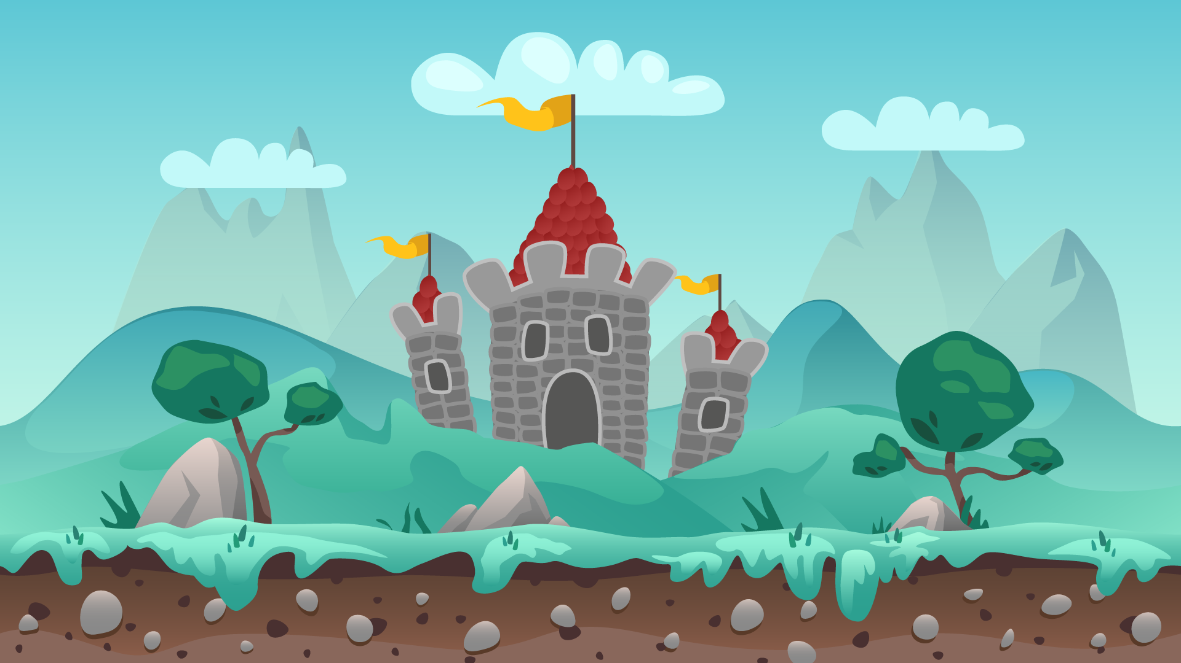
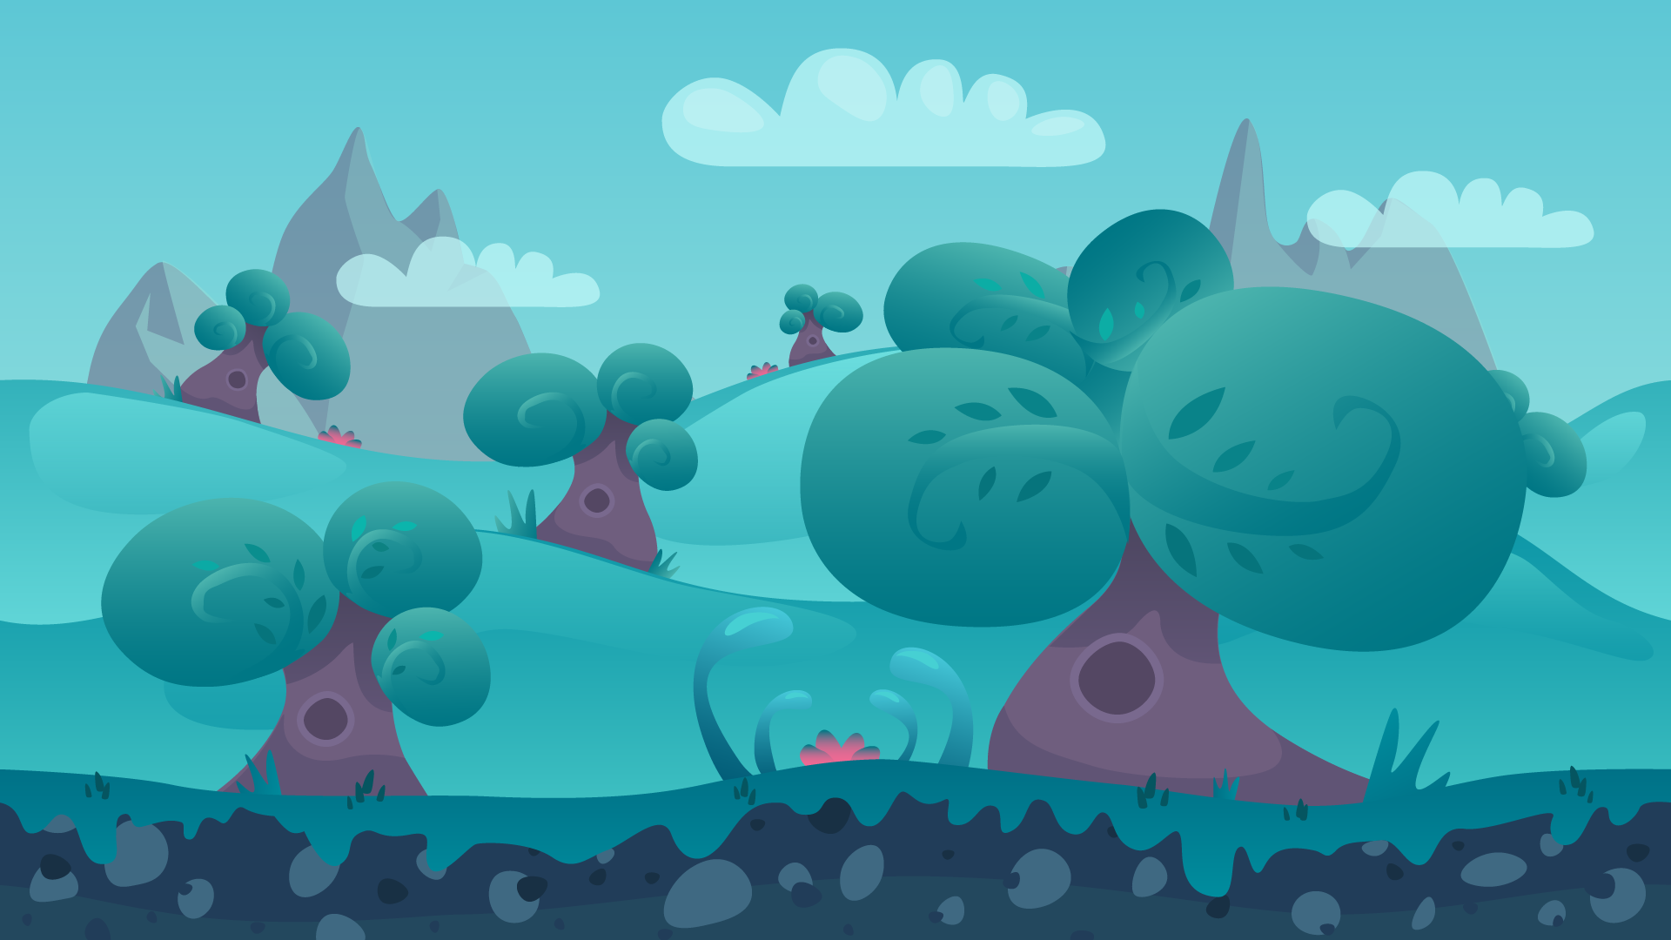
Levels

Slide 9


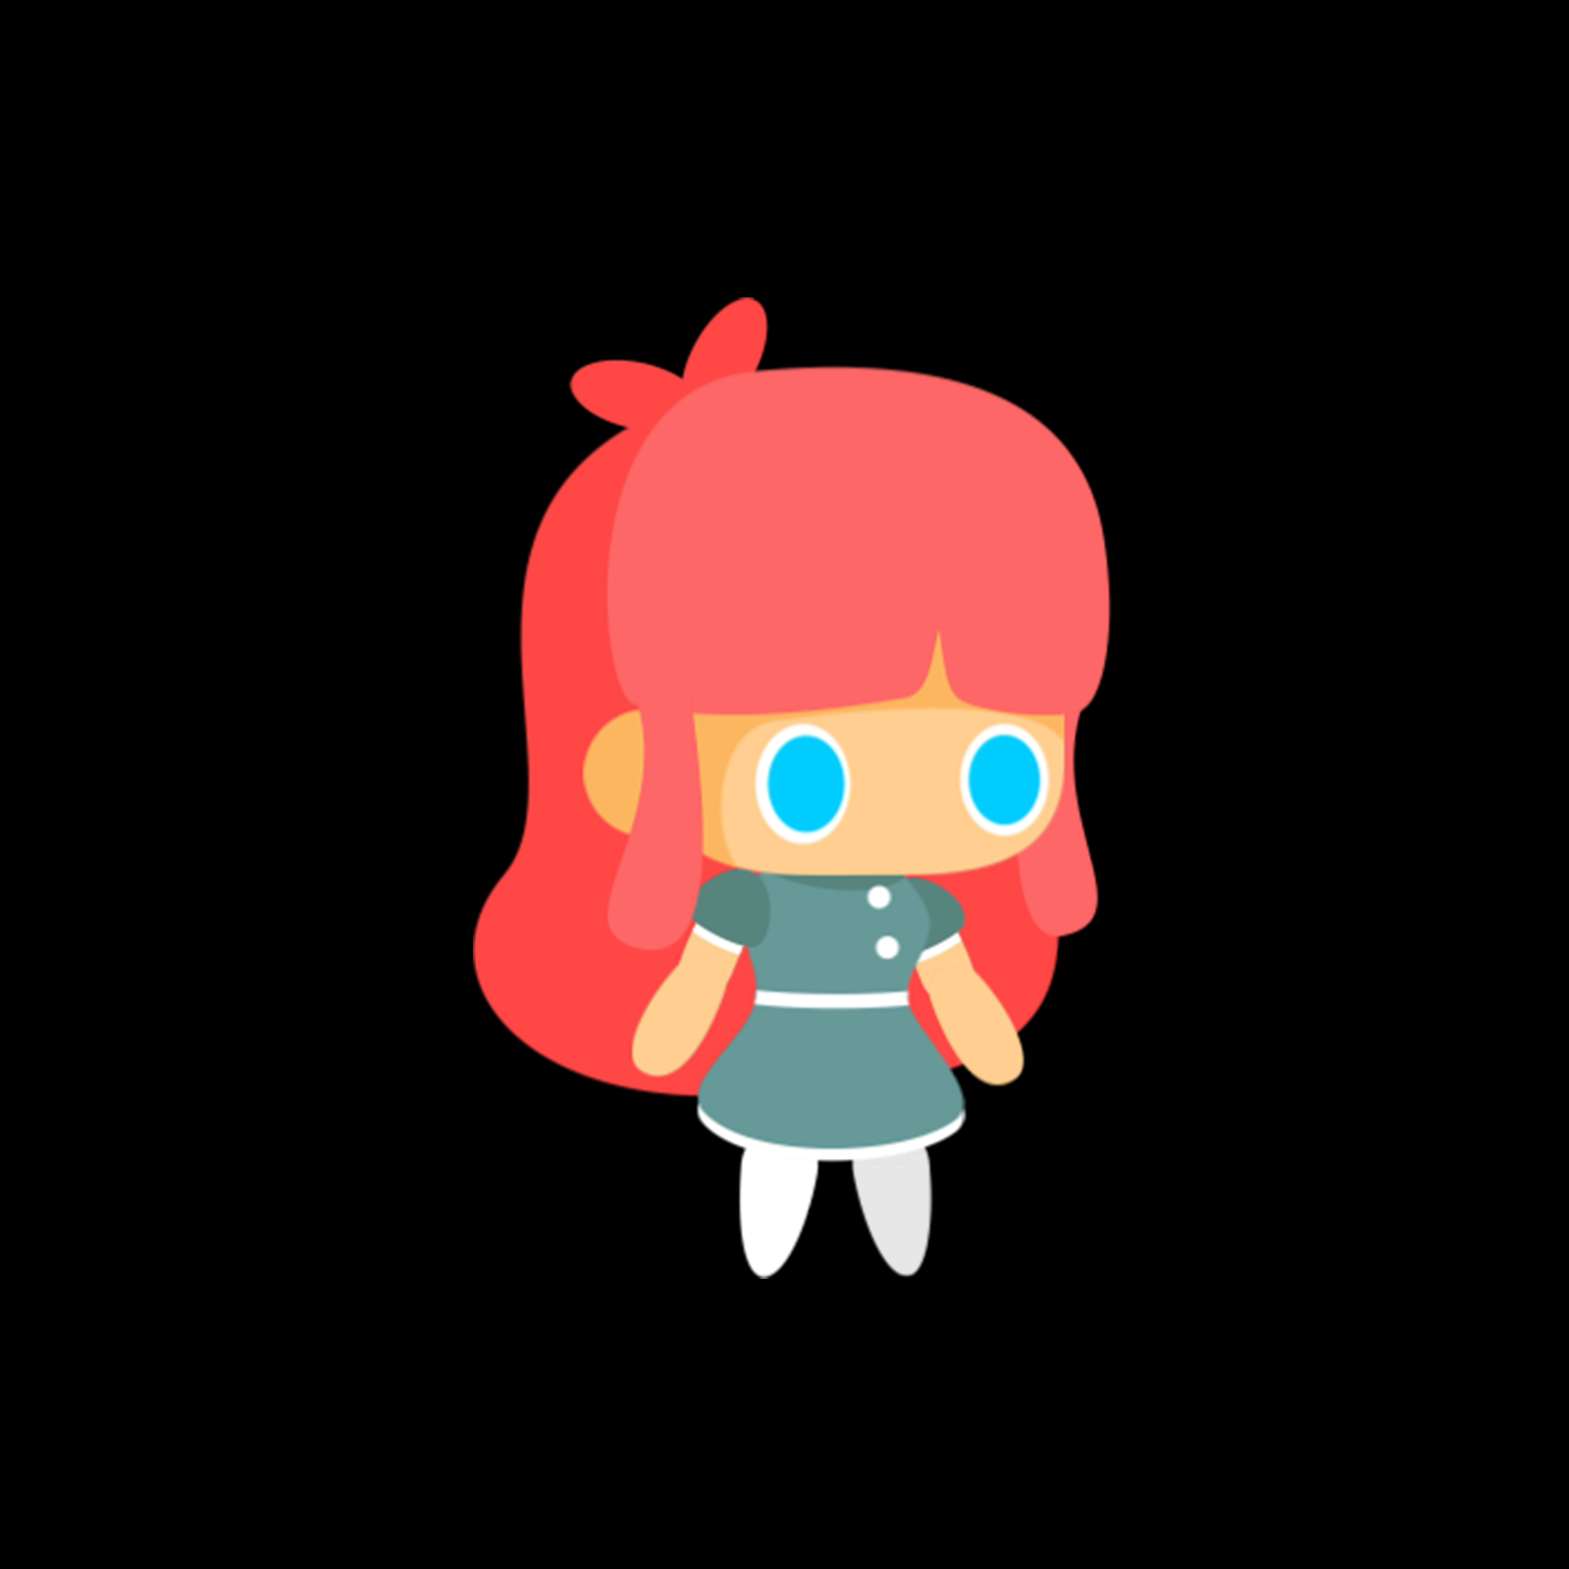


Animations

Slide 10
Current Progress

